Slide 1
Drug information
Here is where your presentation begins
By: Dr. Riffat Ibrahim Riffat

Slide 2
Classifying Causality of an ADR
*Definite causality—when a clinical event (including laboratory test ) occurs in a plausible time relationship to medicine administration and cannot be explained by concurrent disease or other medicines or chemicals; re- administration of the medicine causes a similar reaction
*Probable (or likely) causality—when a clinical event occurs with a reasonable time sequence to medicine administration and is unlikely to be due to any concurrent disease or other medicine administration

Slide 3
Classifying Causality of an ADR
§Possible causality—when a clinical event occurs with a temporally time sequence to medicine administration and could be explained by concurrent disease or other medicine administration.
§Doubtful or Unlikely causality:—when a clinical event occurs in temporal relationship to medicine administration that makes a causal relationship improbable, and when other medicines, chemicals, or underlying disease provide plausible explanations.

Slide 4
-Strength of the association .
-Observed evidences ( Lab tests & medical reports ).
Dose-response relationship .

Slide 5
Methods for assessing ADRs causality
• 1. Expert judgment/Global introspection:
• This method involves the individual assessment of the event by a health care practitioner, based on his or her clinical knowledge and experience without using any form of standardized tool.
• 2. Algorithm:
• This method uses specific questions to assign a weighted score that helps determine the probability of causality in a given reaction .

Slide 6
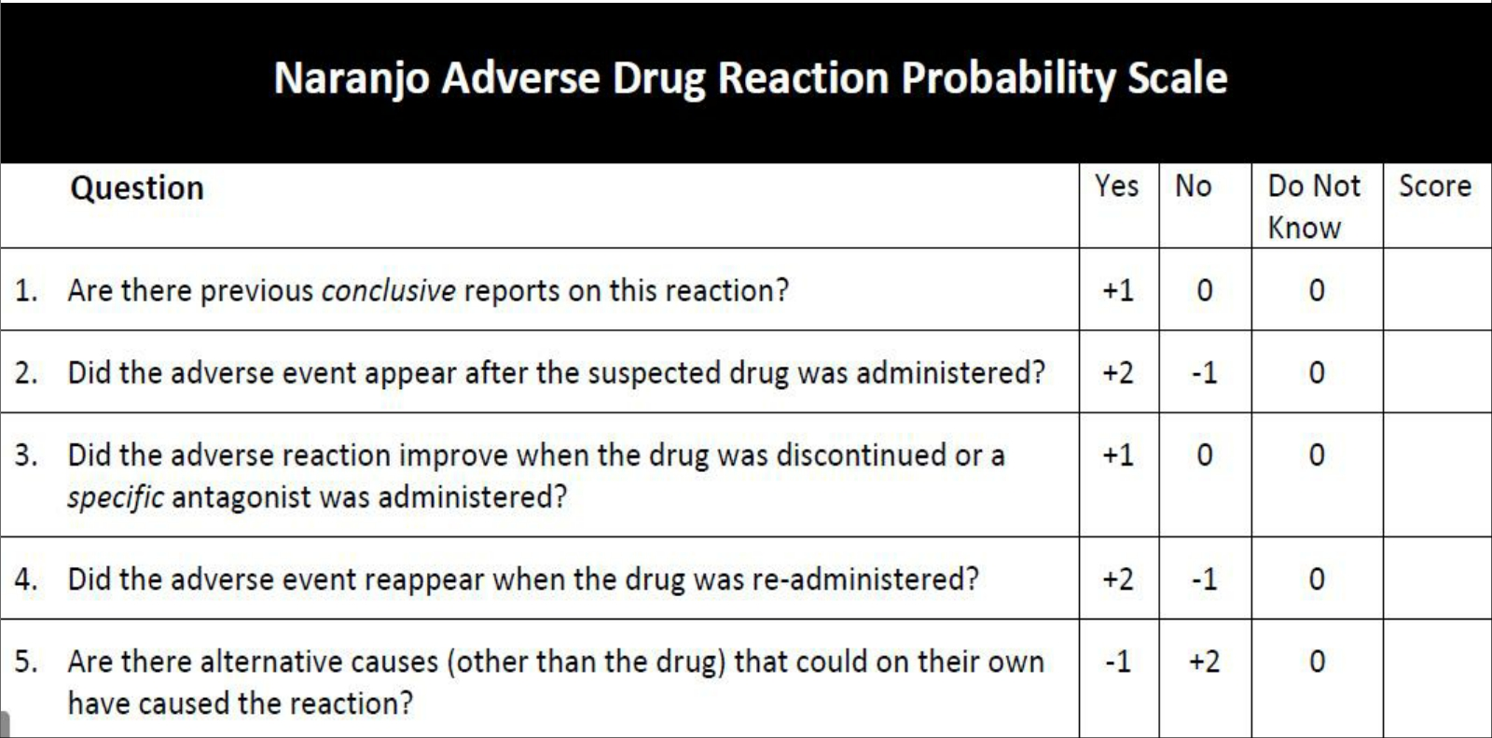
3. advanced statistical methods.

Slide 7
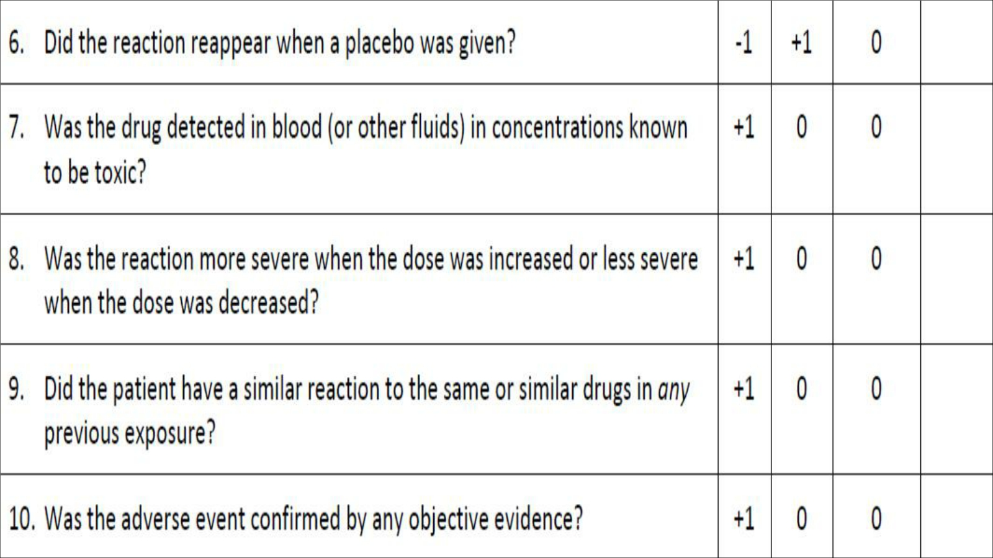

Slide 8
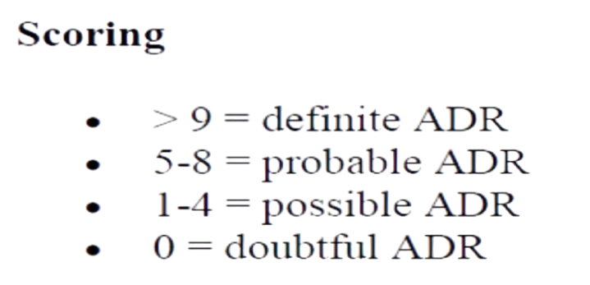

Slide 9


Slide 10
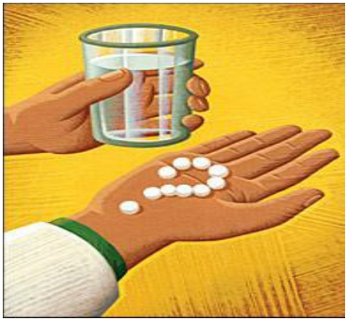
Definition:
Any preventable event that may cause or lead to inappropriate medication use or patient harm while the medication is in control of the health care professional, or patient.

Slide 11


*RISK FACTORS FOR ERRORS
-Lack of knowledge ( Physician , pharmacist and nurse )
-Unclear labeling of drug.
-Misidentification of patient.
-Mental lapses .
-Verification errors .

Slide 12

Causes of errors:
1-Errors of Omission:
• a mistake that consists of not doing something you should
have done .
• Errors related to prescription, drug dispensing by pharmacist,
drug administration by medical personnel like nurses &
patient themselves.

Slide 13
2-Errors of Commission:
a mistake that consists of doing something wrong due to Lack of knowledge .
Types of errors:
1-Prescribing errors.
2-Dispensing errors.
3-Administration errors.

Slide 14
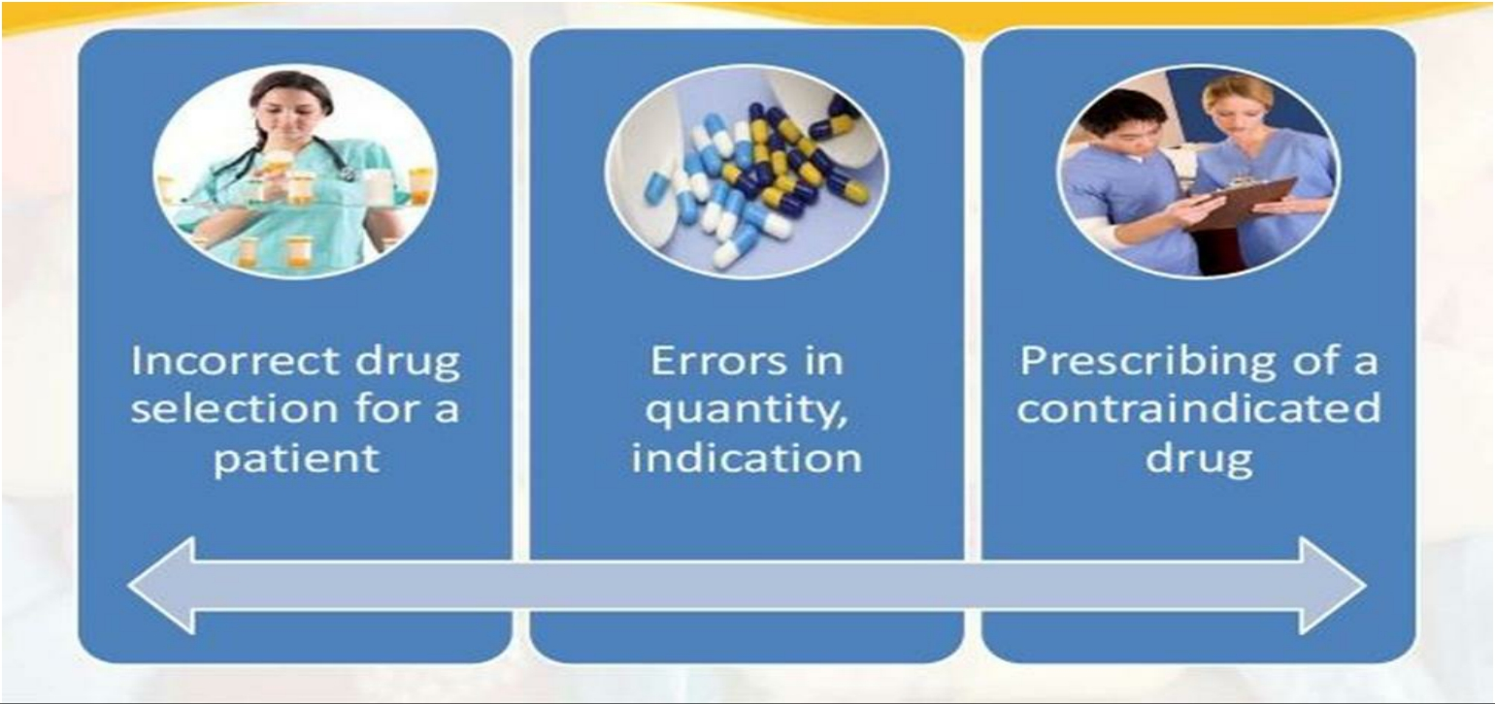
Prescribing errors:

Slide 15
*Risk Factors for prescribing errors:
1-Inadequate training.
2-lack of knowledge.
3-load of work.
4-Miscommunication with the team.

Slide 16
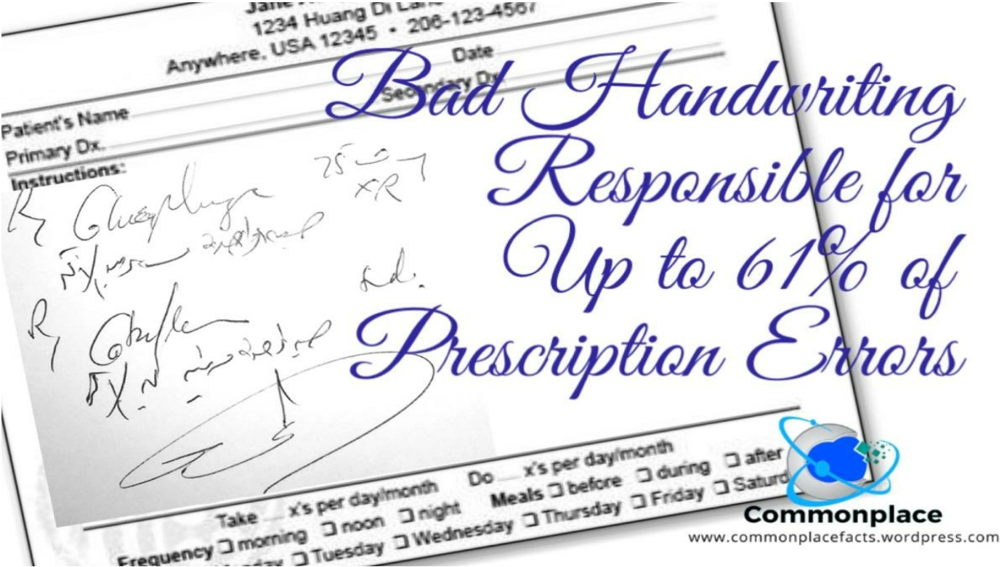

Slide 17
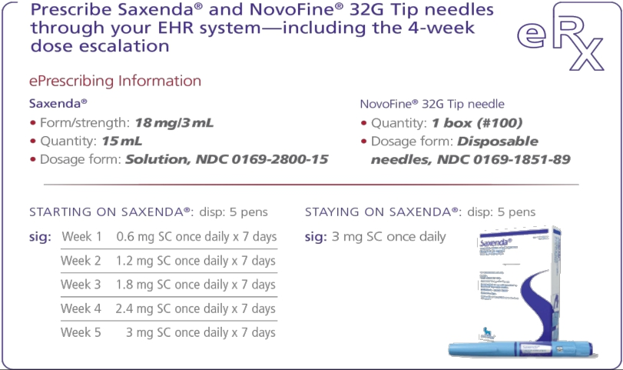
Reducing dispensing errors :
1- Electronic prescribing .
2-Unit dose.
3- Computerizing.
4-Separating drugs with similar name or appearance.

